Slide 1
Lecture Review
Chapter 1: The Review of Robot Kinematics
Chapter 2: Robot Dynamics
Chapter 3: Robot Control
Chapter 4: Robot Force Control
Lecture Review

Slide 2
Chapter 1: The Review of Robot Kinematics
General features of robots
Formulation of Denavit - Hartenberg ( D - H)
Fu, et al
Craig (Different from Fu's)
Robot Kinematics
Direct Kinematics
Inverse Kinematics

Slide 3
Chapter 2: Robot Dynamics
2.1 Newton-Euler formulation
2.2 Lagrange-Euler formulation
2.3 Properties of dynamic models
2.4 Tutorials of dynamics
2.5 Neural network modelling
Generalized Coordinates
Generalized Forces

Slide 4
Chapter 3: Robot Control
3.1 Fundamentals: Stability and Schemes
3.2 Single-joint Control
3.3 Computed Torque Control
3.4 Lyapunov Stability Analysis
3.5 Adaptive Control

Slide 5
Chapter 4: Robot Force Control
4.1 The 1-DOF Force Control
4.2 The n-DOF Force Control
4.3 Impedance Control
4.4 Constrained Motion Control
Concepts and characteristics

Slide 6
Highlight
The Analysis for a 2 DOF manipulator ( $n=2$)
By applying with the Lagrange-Euler equation:
k = 1, ..., n

Slide 7
Highlight
*
Let
Then, the motion equations become
Note that
*
Christoffel Symbols

Slide 8
Highlight
It is common to write the motion equations in matrix form as
joint variable vector
a vector of coriolis and centrifugal forces
a vector of gravity forces

Slide 9
Highlight
Remarks of Robot Dynamics
Model building of the robot dynamics is essential for numerical simulation, and control system design.
General coordinates, forces/torques of robots, joint velocities, and kinetic and potential energies are key concepts in modeling of robot dynamics.

Slide 10
Highlight
Typical dynamic equations of robots in joint space is given as follows:
Properties of the robotic dynamics are significant for control system design.

Slide 11
Highlight
Robot control and simulation
Consider two-link manipulator described by
where
- 11 -

Slide 12
Highlight
Two-link manipulator controlled with the control law
The desired trajectory：
Assuming the parameters vector
The manipulator is initially at rest with
The gains for the controller are chosen as:
- 12 -

Slide 13
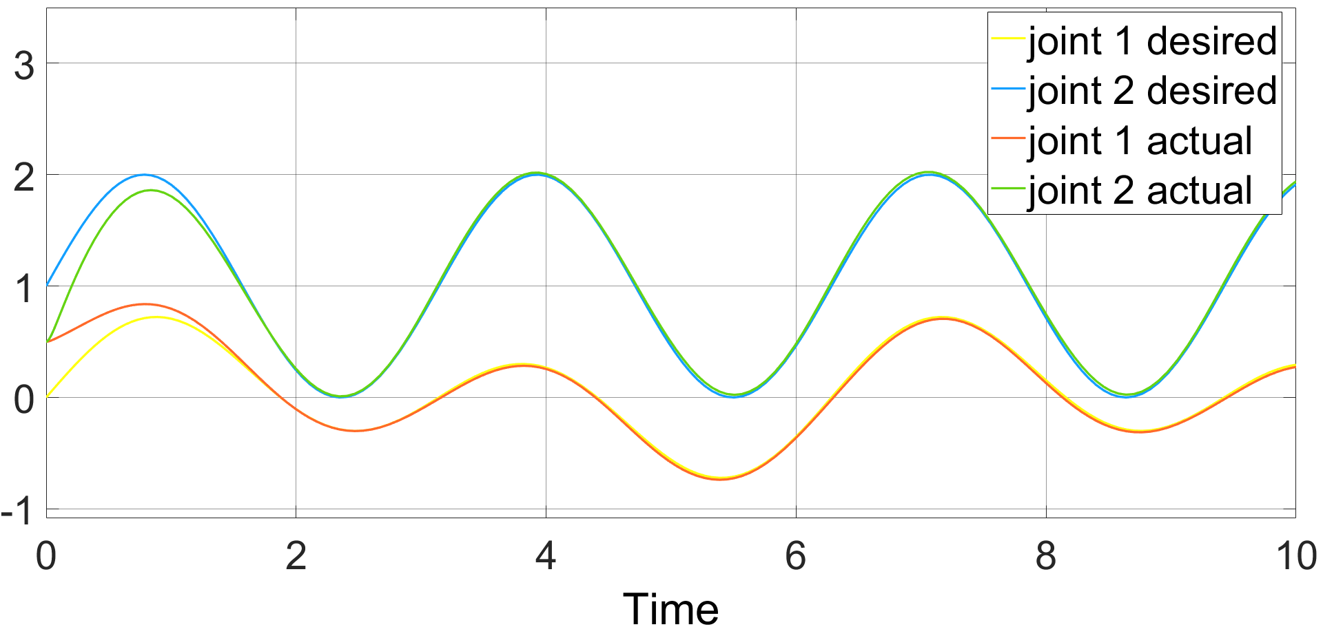
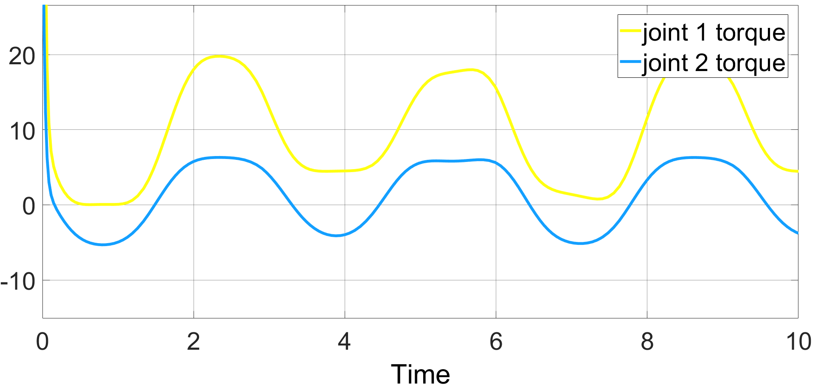
Highlight
Position tracking of joint
Control input of manipulator
Manipulator realizes trajectory tracking by computed torque method

Slide 14
Highlight
Computer Simulation
There are quite a few good commercial software packages available for controller design and simulation of systems, which include MATLAB, MATRIXX, SIMULINK, SIMNON, and so on.
For the nice commercial software available, the complexity of simulation is hidden for the sake of user friendliness, and the software are not optimise either. In practice, it is equally important to write one’s own software for a few different reasons.
- 14 -

Slide 15
Highlight
Computer Simulation
A well-structured sample C code for simulation study of dynamic NN based adaptive control is given.
This simulation software consists of several well-structured files for easy understanding, debugging and maintenance. They are main.c, control.c, path.c, adapRKM.c, robot.c, util.c, user.h and init.dat. The main functionalities of each file are highlighted as follows.
- 15 -

Slide 16
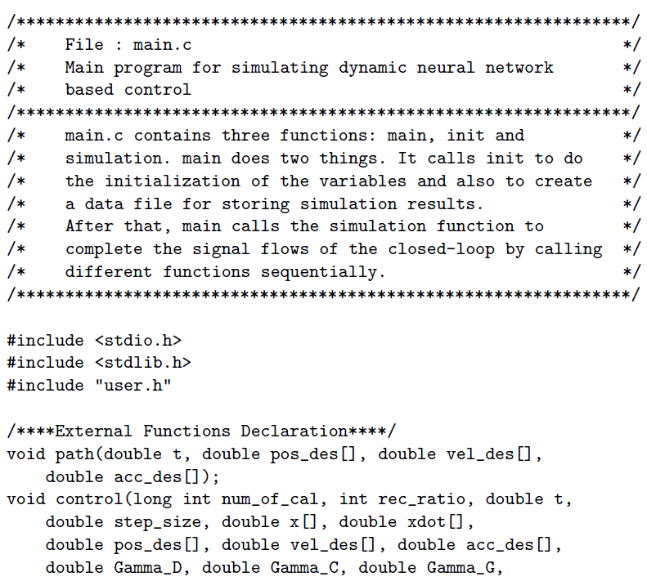
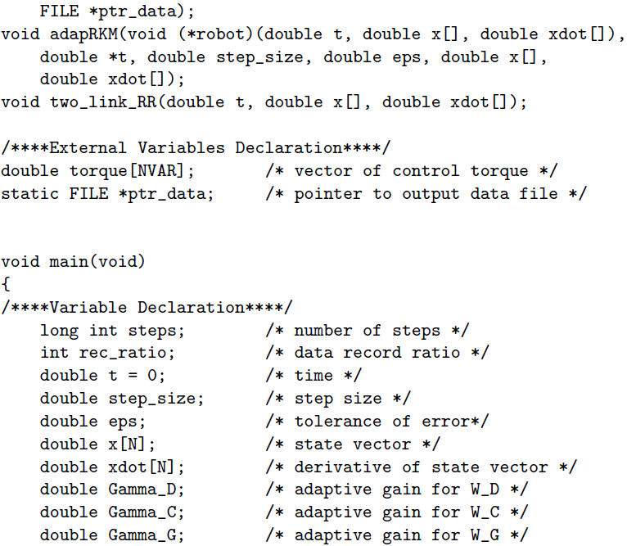
Highlight
Computer Simulation
Main File: main.c
- 16 -

Slide 17
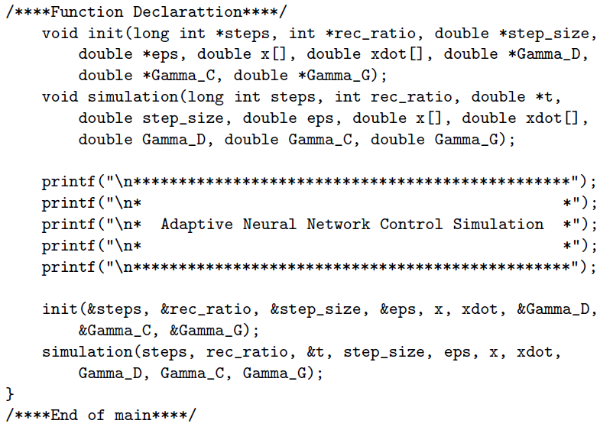
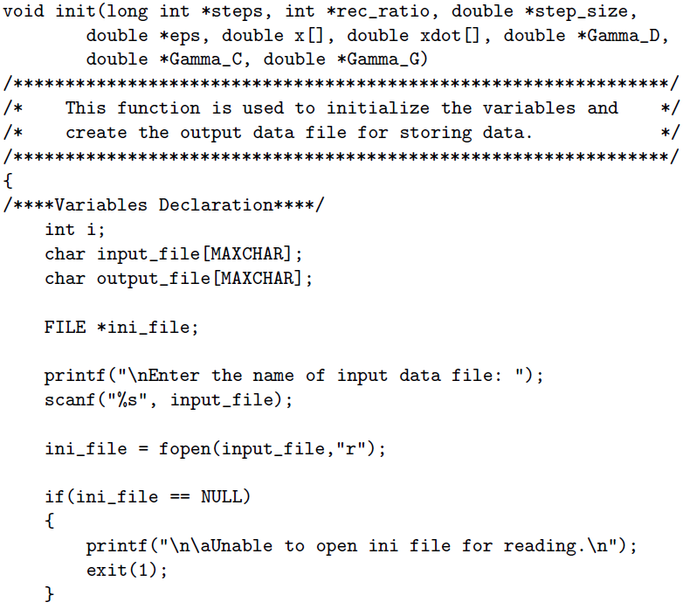
Highlight
Computer Simulation
Main File: main.c
- 17 -

Slide 18
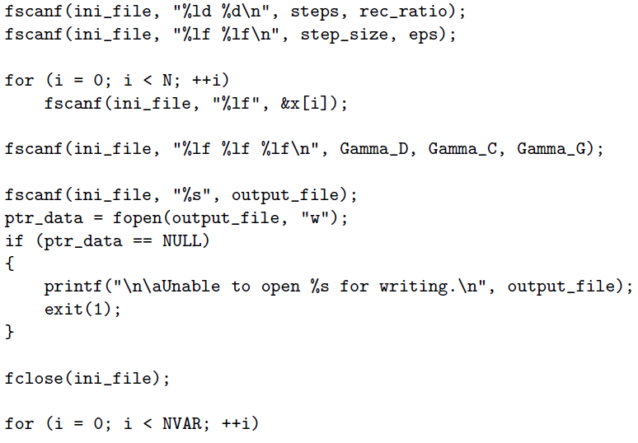
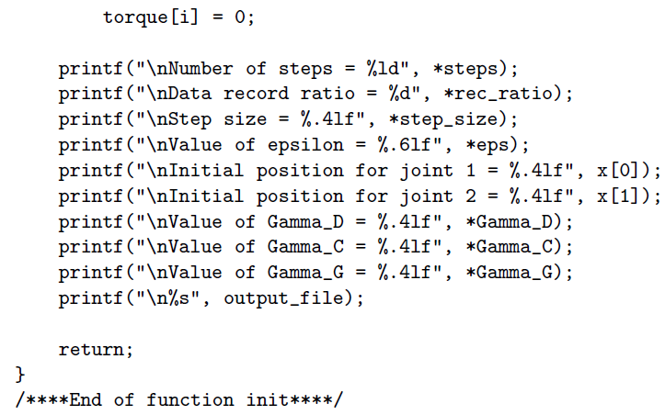
Highlight
Computer Simulation
Main File: main.c
- 18 -

Slide 19
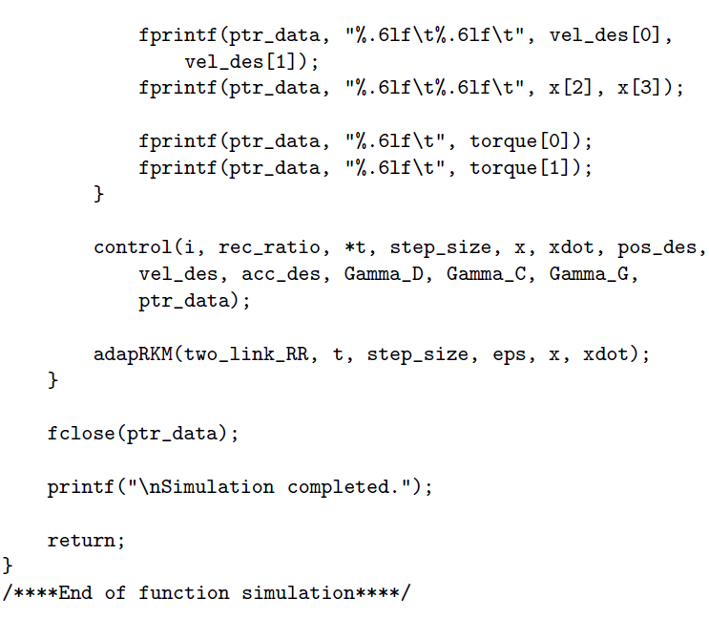
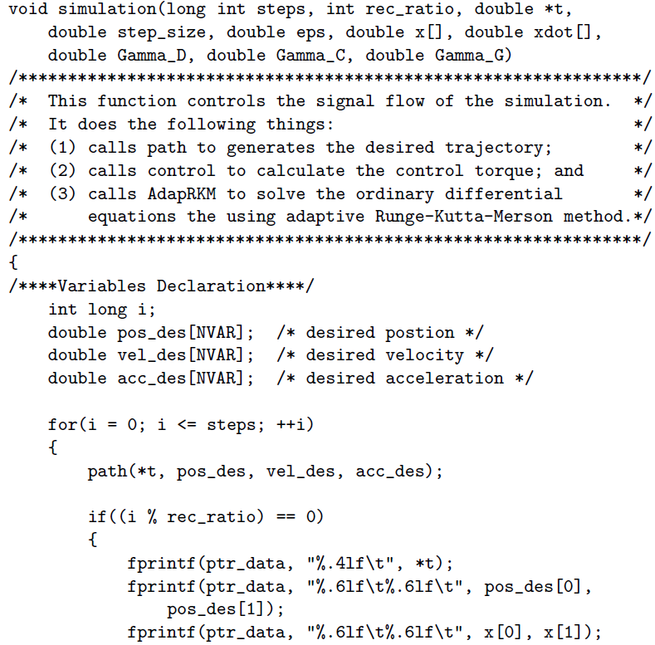
Highlight
Computer Simulation
Main File: main.c
- 19 -

Slide 20
Highlight
Computer Simulation
Main File: main.c
main.c controls the overall flow of the simulation software. It firstly initializes the appropriate variables, then calls different functions to generate the desired trajectories, computes the control actions, and solves the ordinary differential equations numerically using the adaptive step size technique, and finally stores the data into different files for further analysis.
- 20 -

Slide 21
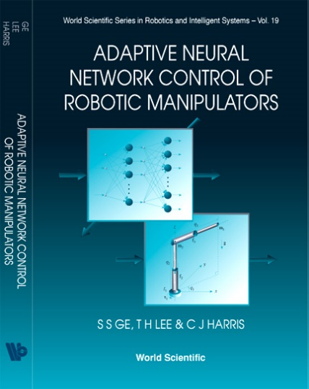
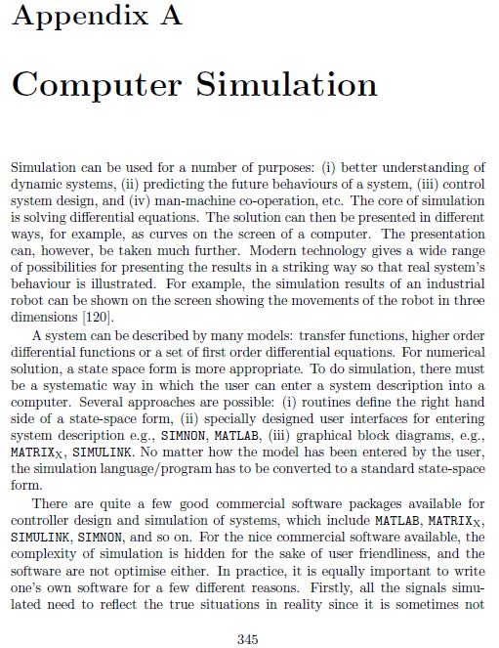
Highlight
Computer Simulation
The complete C code and controller can be referred to the following book (p345):
S. S. Ge, T. H. Lee, and C. J. Harris. Adaptive neural network control of robotic manipulators. Vol. 19. World Scientific, 1998
- 21 -

Slide 22
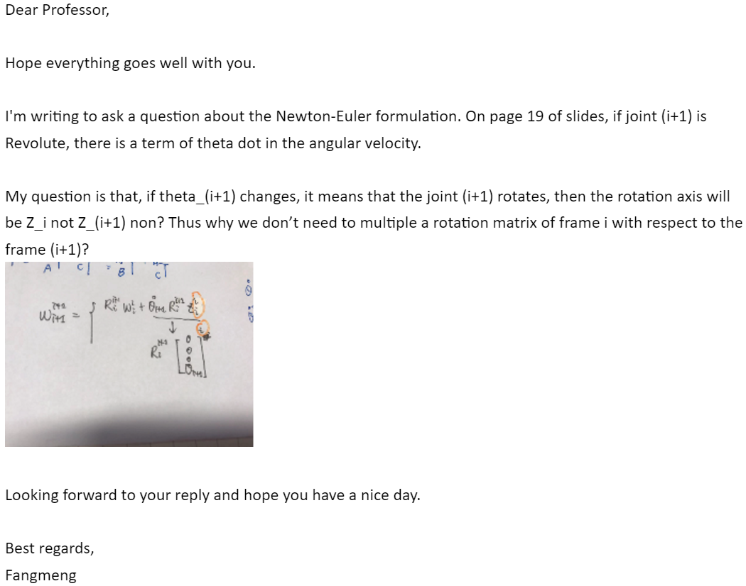
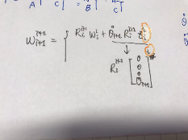
Q&A.1
Question:

Slide 23
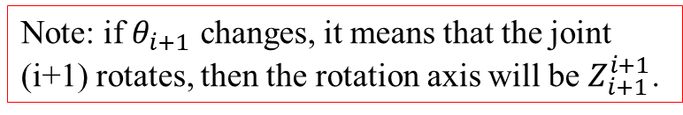
Q&A.1
Answer:
lecture note 2.1 Newton-Euler formulation p19
Forward-Backward Algorithm
Note: if $θ_{i+1}$ changes, it means that the joint (i+1) rotates, then the rotation axis will be $Z_{i+1}^{i+1}$.
is the direction vector of the rotation axis of the joint i+1 in the coordinate system i+1.
is the transformation matrix of the coordinate system.

Slide 24

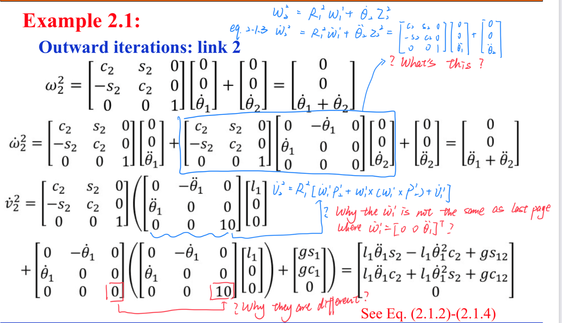
Q&A.1
Question:

Slide 25
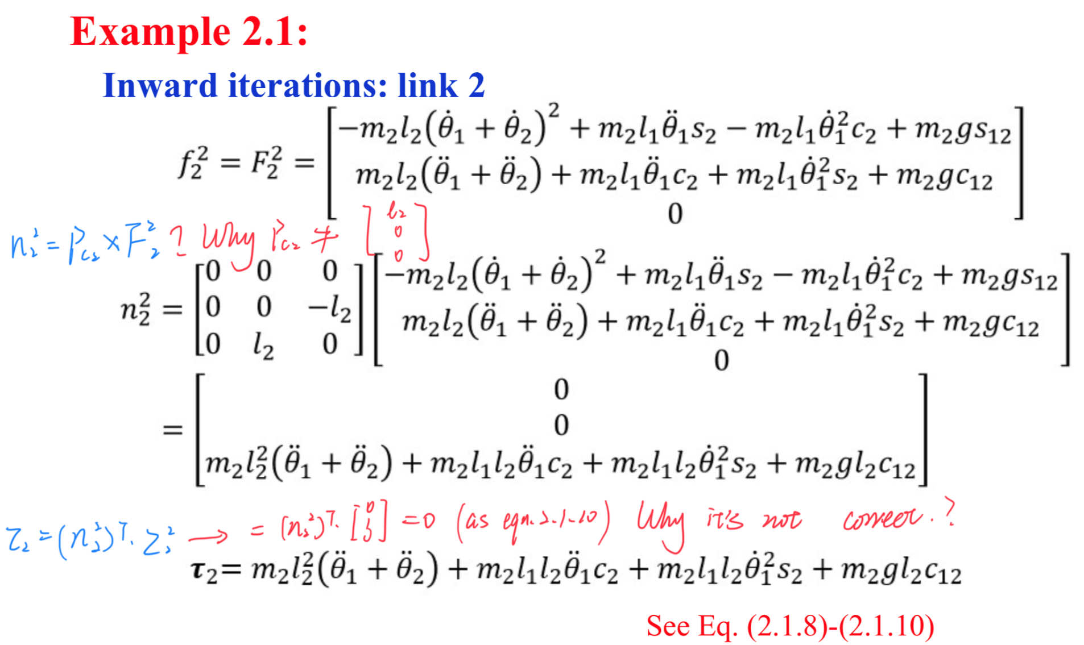
Q&A.2
Question:

Slide 26
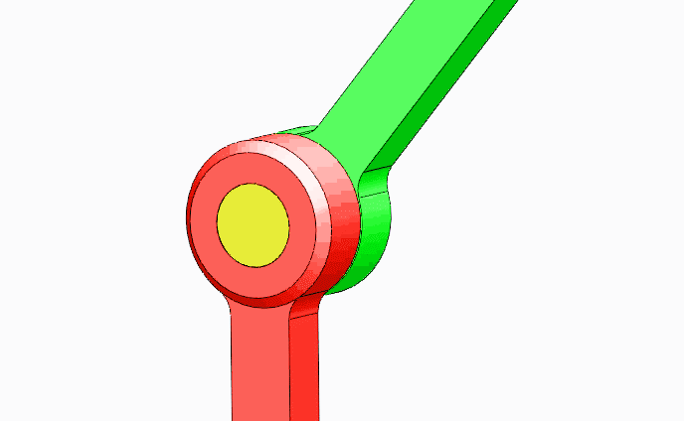
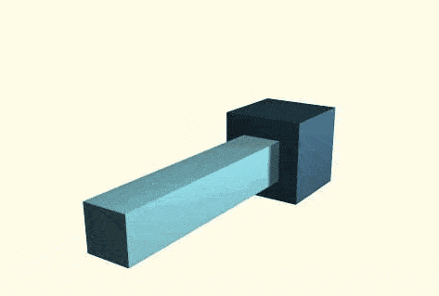
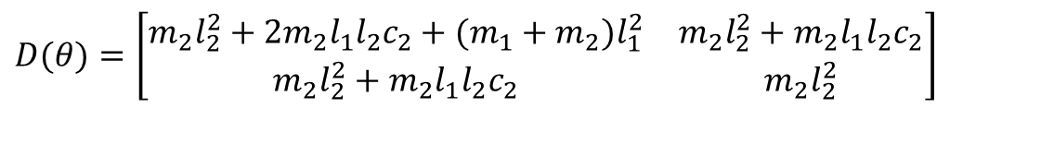
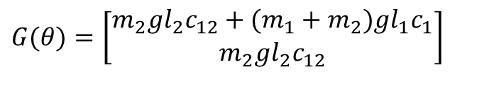
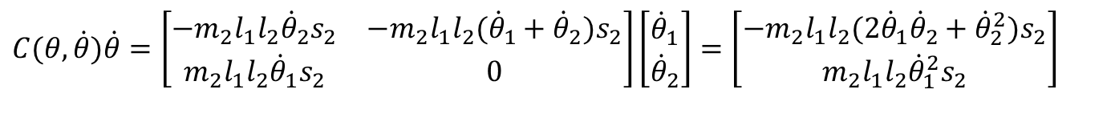
Q&A.2
Answer:
lecture note 2.1 Newton-Euler formulation p19
Eq. (2.1.3) should be
(2.1.3)
lecture note 2.1 Newton-Euler formulation p30
The dynamic equation should be
$$D(θ)=\left[\begin{matrix}m_{2}l_{2}^{2}+2m_{2}l_{1}l_{2}c_{2}+(m_{1}+m_{2})l_{1}^{2} & m_{2}l_{2}^{2}+m_{2}l_{1}l_{2}c_{2} \\ m_{2}l_{2}^{2}+m_{2}l_{1}l_{2}c_{2} & m_{2}l_{2}^{2}\end{matrix}\right]$$
$$C(θ,\dot{θ})\dot{θ}=\left[\begin{matrix}−m_{2}l_{1}l_{2}{\dot{θ}}_{2}s_{2} & −m_{2}l_{1}l_{2}{({\dot{θ}}_{1}+\dot{θ}}_{2}{)s}_{2} \\ m_{2}l_{1}l_{2}{\dot{θ}}_{1}s_{2} & 0\end{matrix}\right]\left[\begin{matrix}{\dot{θ}}_{1} \\ {\dot{θ}}_{2}\end{matrix}\right]=\left[\begin{matrix}−m_{2}l_{1}l_{2}(2{\dot{θ}}_{1}{\dot{θ}}_{2}+{\dot{θ}}_{2}^{2})s_{2} \\ m_{2}l_{1}l_{2}{\dot{θ}}_{1}^{2}s_{2}\end{matrix}\right]$$
$$G(θ)=\left[\begin{matrix}m_{2}gl_{2}c_{12}+(m_{1}+m_{2})gl_{1}c_{1} \\ m_{2}gl_{2}c_{12}\end{matrix}\right]$$

Slide 27

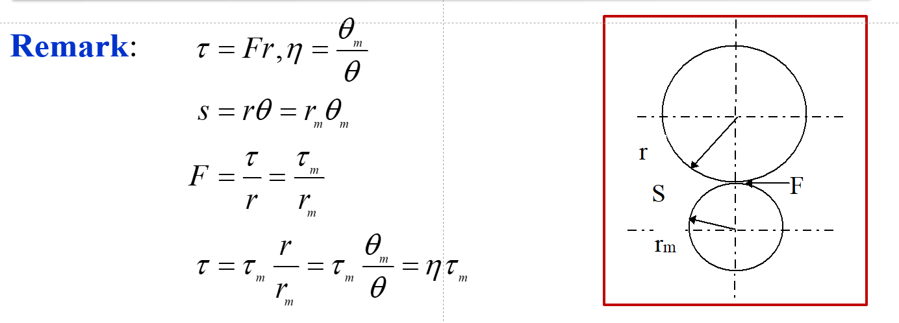

Q&A.3
Question:
Answer:

Slide 28
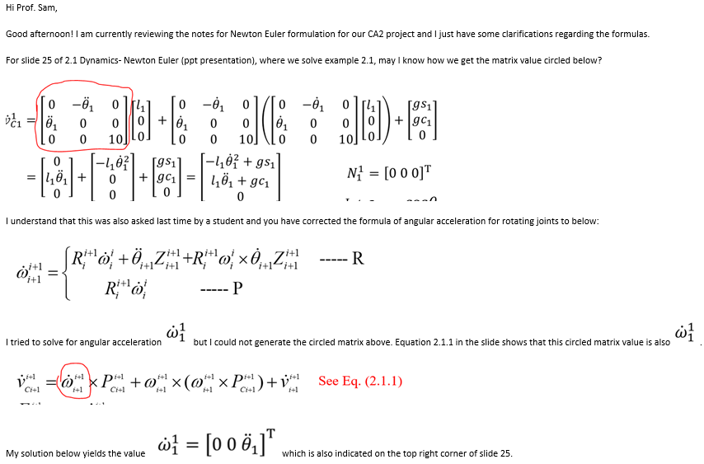
Q&A.4
Question:

Slide 29
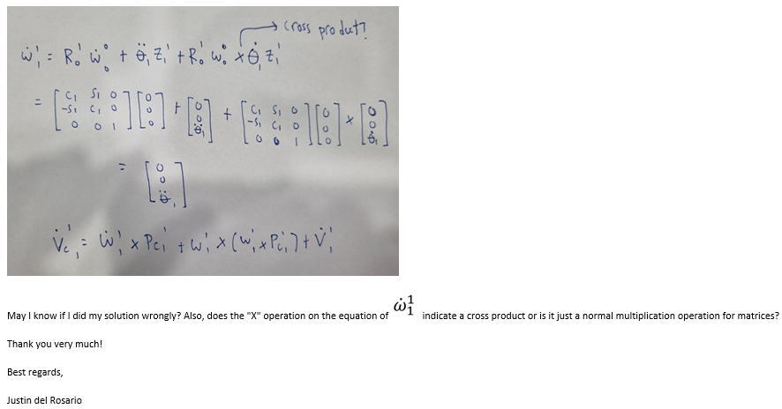
Q&A.4
Question:

Slide 30
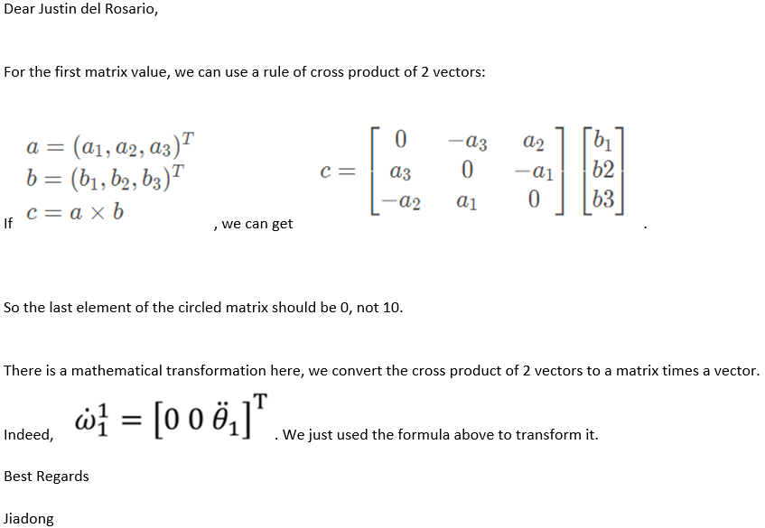
Q&A.4
Answer:

Slide 31
Exam Schedule
Time: 13:00, 26-04-2022
Form: Open Book
Venue: LT7A
Be Steady and Confident!

Slide 32
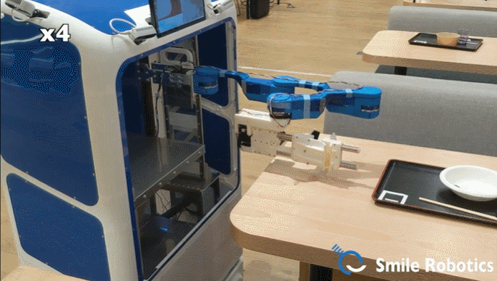
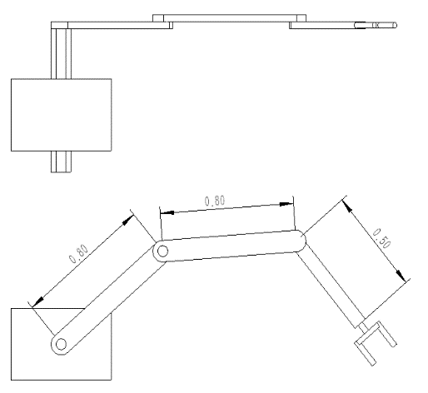
Mini Project
Project 1:
1. Modeling and Animation of the ACUR-C table cleaning robot
ACUR-C, a table cleaning robot is a typical intelligent robot. Such a robot processes 4 degrees of freedom (DOFs) and works in a 3-D space. A table cleaning robot contains 4 degrees of freedom, including 1 degree of freedom for up and down movement and 3 degrees of freedom for arm plane movement.
Task 1: Introduction and Literature Review
Task 2: Kinematics and Computing
Task 3: Dynamics and Computing
Task 4: Control Design and Simulation
Task 5: Conclusions and Further Studies

Slide 33
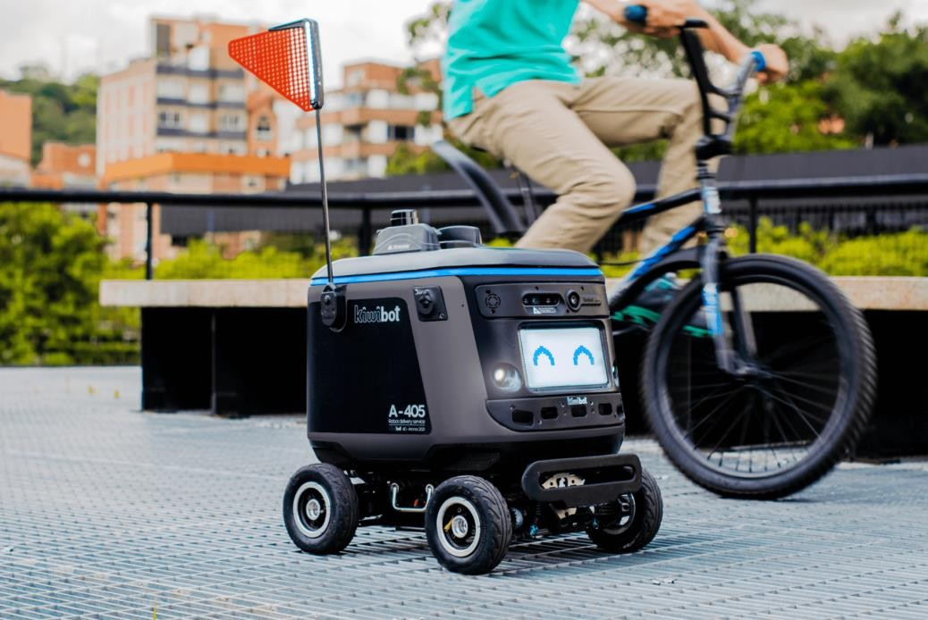
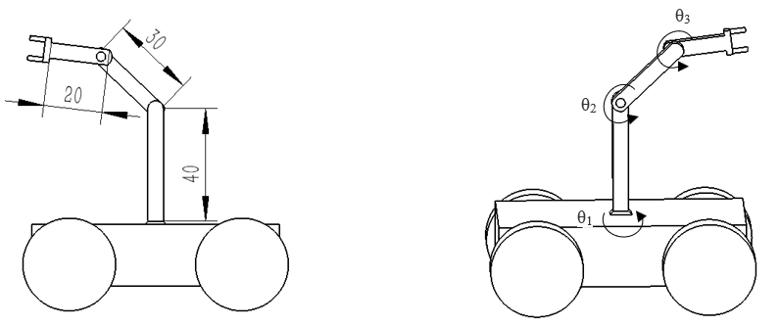
Mini Project
Project 2:
2. Modeling and Animation of the four-wheel autonomous robot
In this project, we consider modelling and control of a four-wheel autonomous robot based on the Kiwibot. This four-wheel model is to execute moving and turning. Assume that two front wheels are the driving wheels and the others are the driven wheel. On top of it, we add a 2-link robot arm on the center top of the robot. Both these two joints are revolute joint.
Task 1: Literature Review
Task 2: Kinematics and Computing
Task 3: Dynamics and Computing
Task 4: Control Design and Simulation
Task 5: Conclusions and Further Studies

Slide 34
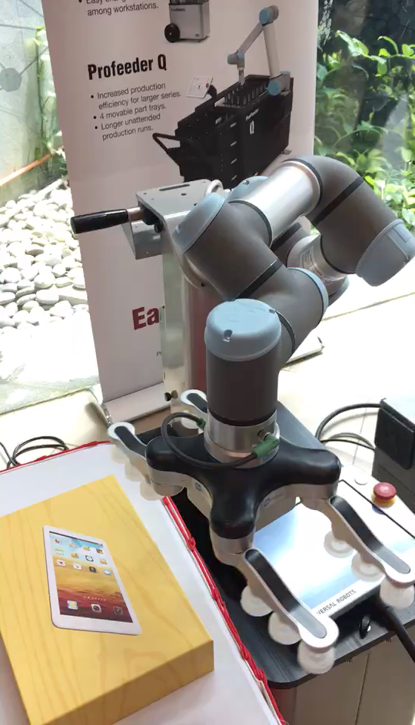
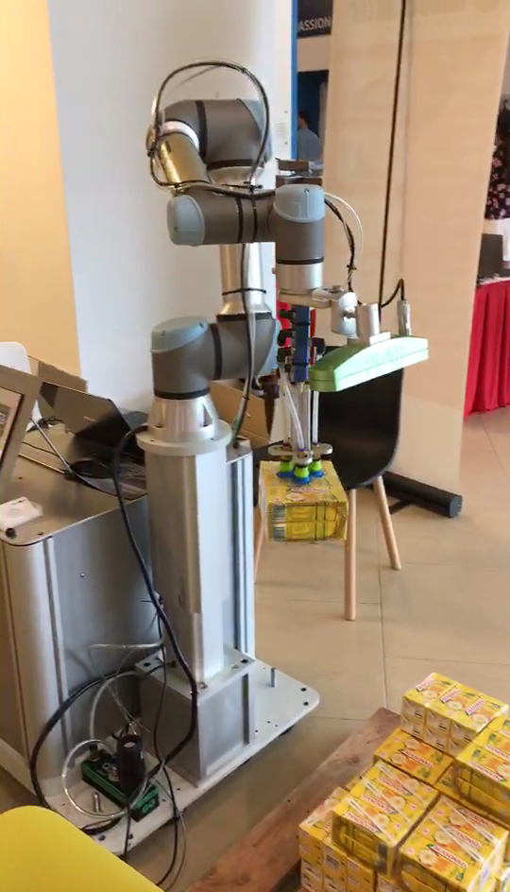
Mini Project
Project 3: Innovative Design, Examples of Mini Project
https://www.youtube.com/watch?v=tGn9gpmPrms
https://www.youtube.com/watch?v=Vpr1cE44Lpw
https://www.youtube.com/watch?v=M2sv3rRWUgo
Several cases for different robot manipulator applications, which may enlighten you in doing the project project for sense of achievement.

Slide 35
Mini Project
The Reference Sample for Mini Project
[1] Alakshendra, Veer, and Shital S. Chiddarwar. "Adaptive robust control of Mecanum-wheeled mobile robot with uncertainties." Nonlinear Dynamics 87.4 (2017): 2147-2169.
[2] Serrezuela, Ruthber Rodríguez, et al. "Kinematic modelling of a robotic arm manipulator using Matlab." ARPN Journal of Engineering and Applied Sciences 12.7 (2017): 2037-2045.
[3] Pacheco, Lluis, and Ningsu Luo. "Testing PID and MPC performance for mobile robot local path-following." International Journal of Advanced Robotic Systems 12.11 (2015): 155.
[4] Surapong, Niphun, and Chowarit Mitsantisuk. "Position and force control of the SCARA robot based on disturbance observer." Procedia Computer Science 86 (2016): 116-119.

Slide 36
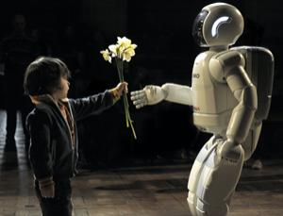
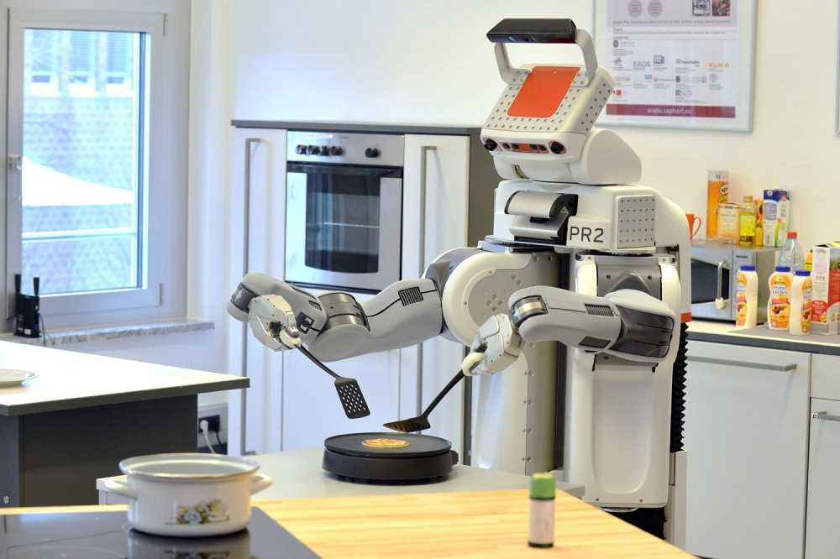
Beyond: Interactive Social Robots
With the growing research interest in application fields such as service, health care, entertainment, etc., robots are expected to be able to work in unknown environments.
- 36 -

Slide 37
Beyond: Interactive Social Robots
Most traditional robot controllers designed with the presumption that the external environment is fixed
will NOT apply.
What is needed to be investigated?
Unexpected interaction between robots and unknown environments.
- 37 -

Slide 38
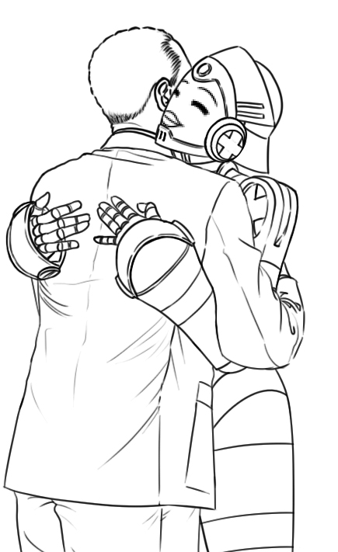
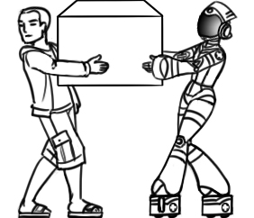
Beyond: Interactive Social Robots
combine human's perception ability and robot's load sharing capability
human-robot cooperation
Make the robot understand the motion intention of the human partner
- 38 -

Slide 39

Beyond: Interactive Social Robots
Based on the above discussion, new strategies for interactive robot control are yet to be developed.
- 39 -

Slide 40
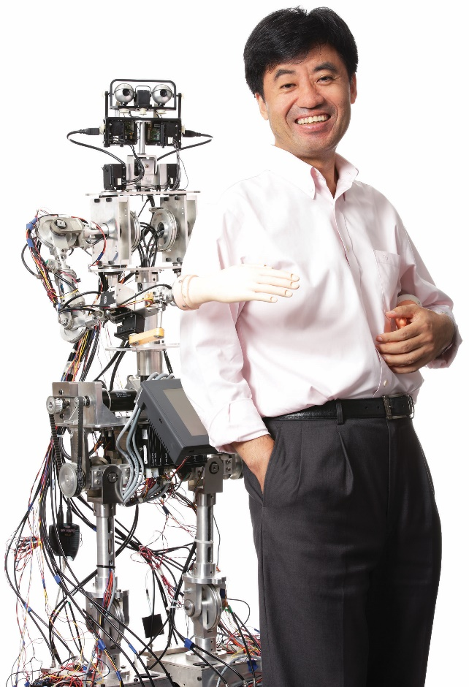
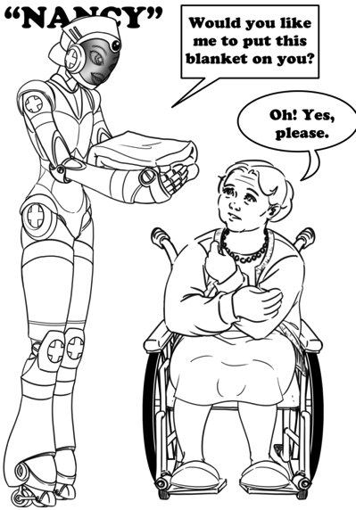
Nancy: Human-Robot Interaction
Friendly/Safe Interaction
Physical Assistance
Smart/Adaptive Control
- 40 -

Slide 41
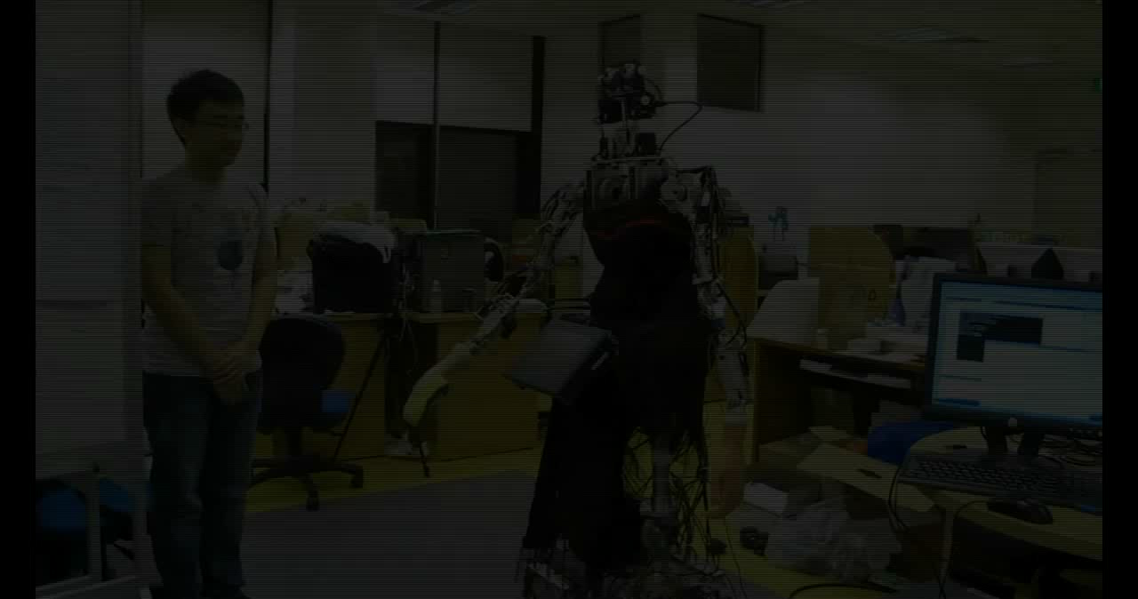
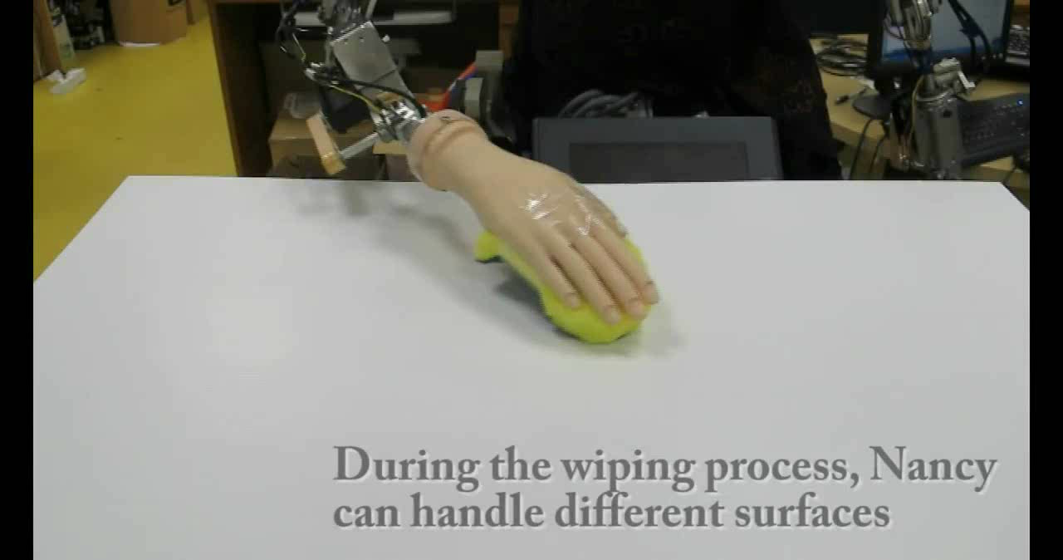
Nancy: Human-Robot Interaction
Examples:
Following
Cleaning
Handshaking
- 41 -
Notes:
Too many fonts

Slide 42

Intelligent Control
Compliant Interaction with Environment
Impedance Controller
+
Position Controller
Position Error
Robot
Environment
Desired Trajectory
Virtual Desired Trajectory
-
Position Feedback
Interaction Force
Unknown robot dynamics:
Adaptive Control
Learning Control
Neural Networks Control
Physical Human-Robot Interaction
Target impedance model:
- 42 -

Slide 43
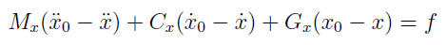
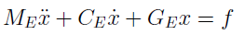
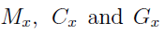
Problem Formulation
The dynamics of a robot arm follow an impedance model:
Consider that the environment is unknown and dynamically changing, and it is described by
Problem: How to determine so that a desired interaction performance is guaranteed?
- 43 -

Slide 44
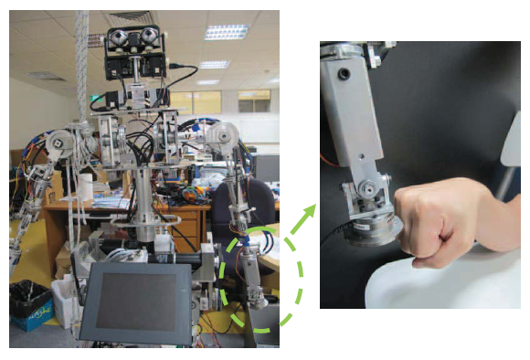
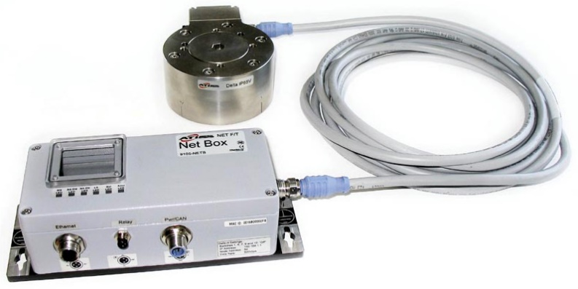
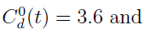
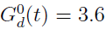
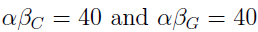
Experiment Study
ATI 6 axis force/torque sensor
Scenario: In each iteration with a period of 18s, the interaction starts at t = 5s and ends at t = 16s.
Unknown environment: human hand
Initial impedance parameters:
Learning rate:
- 44 -

